Slide 1
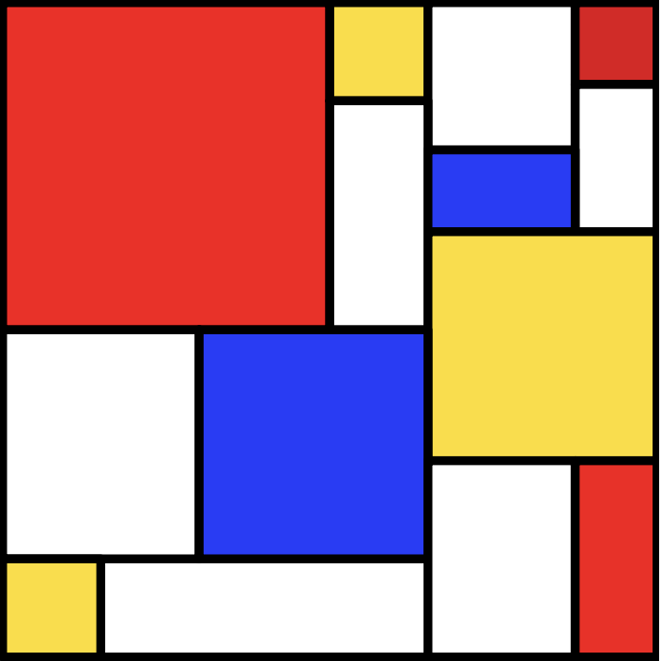
SLiM: An Evolutionary Simulation Framework
CompBio Skills Seminar
4/25/24

Slide 2
Introduction
Advantages:
Flexibility
Performance
Interactive GUI

Slide 3
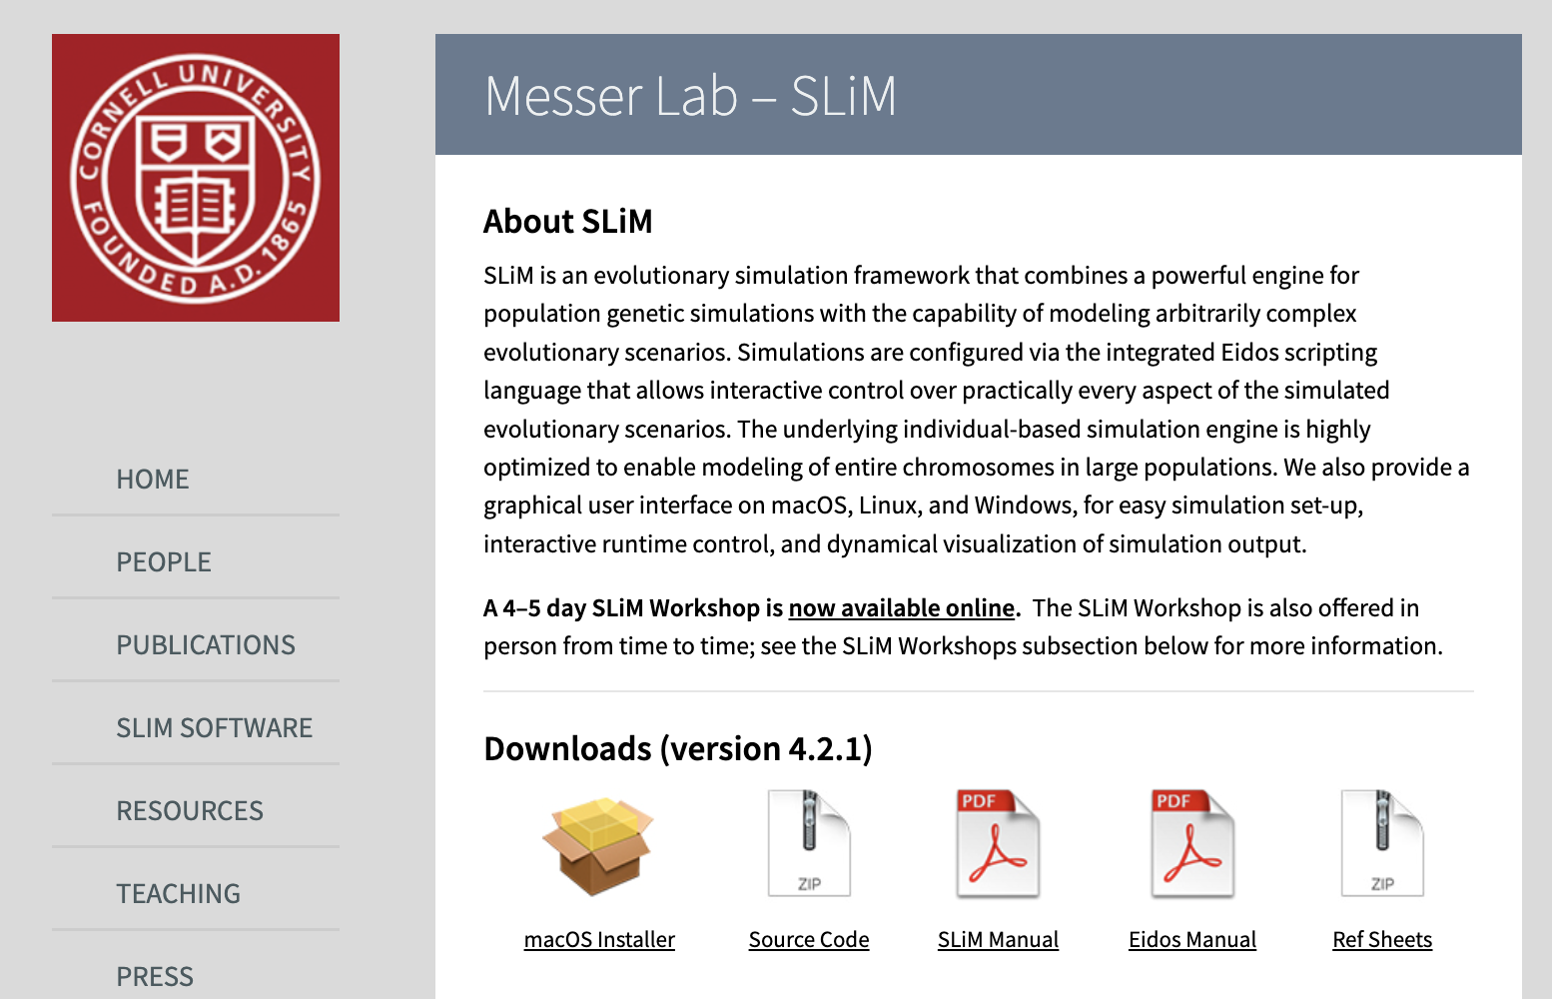
https://messerlab.org/slim/
Notes:
Downloading and running the macOS installer should install SLiM and the SLiMgui (found in applications folder)

Slide 4
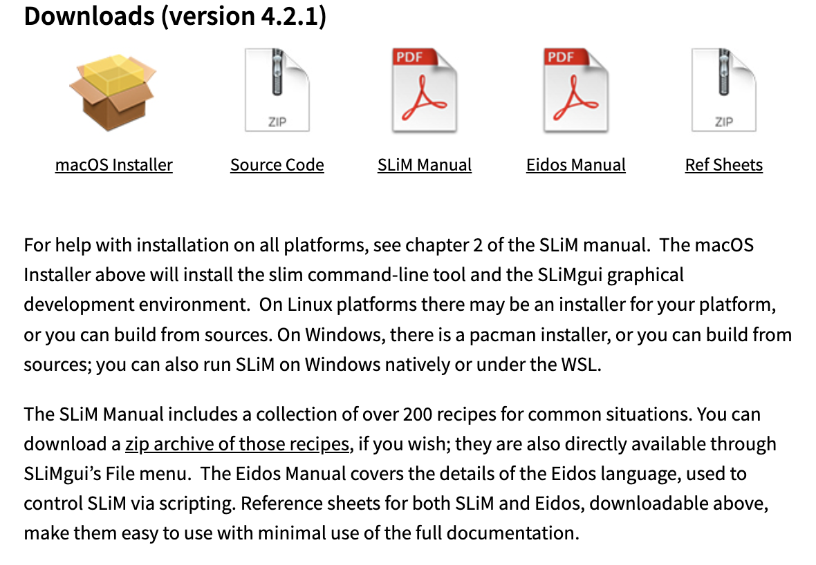
Notes:
-Download the zip archive to get pre-written scripts for common use cases
-I’ll be going through some of these, will be helpful to follow along

Slide 5
Installing on Windows machines
Requires MSYS2 Software Distribution and Building Platform for Windows (https://www.msys2.org/)
Click on ‘MSYS2 MSYS’ in the Start menu
Type ‘pacman -S mingw-w64-x86_64-slim-simulator’ in the opened command prompt
→ This should install SLiM and the SLiMgui

Slide 6
• slim: /usr/local/bin/slim
• SLiMgui: /Applications/SLiMgui.app
• eidos: /usr/local/bin/eidos
• EidosScribe: /Applications/EidosScribe.app

Slide 7
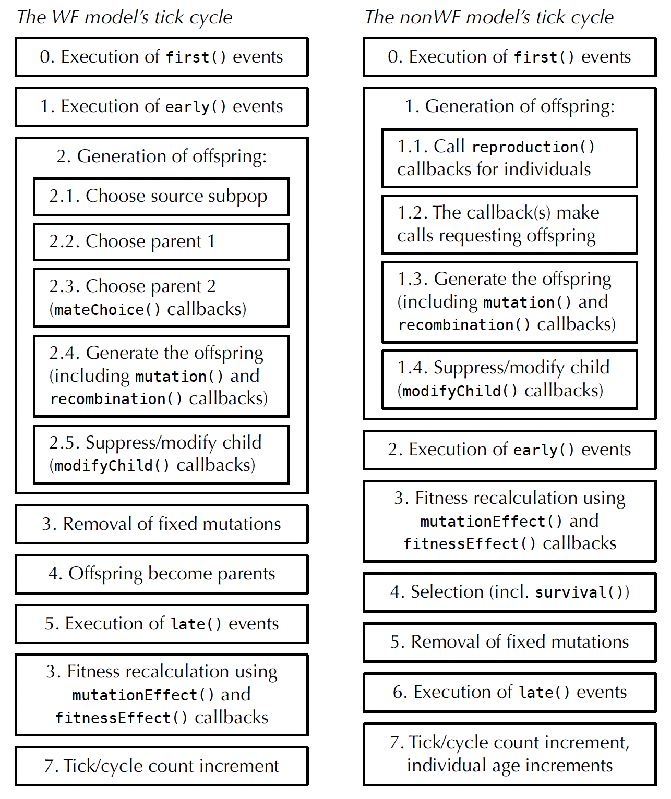
Notes:
-WF (default) vs non-WF - use non-WF for more complicated models (will demo at end)
-all models have several required ‘events’ and optional callbacks
-different structure surrounding how fitness is defined, and the order of some events
-WF: fitness affects probability of reproducing
-nonWF: affects probability of surviving to next gen (where you will reproduce; chance of reproduction not determined by fitness)

Slide 8
WF vs non-WF models
WF is the ‘default’ mode, non-WF is used to explicitly model various ‘advanced’ scenarios

Slide 9
WF vs non-WF models
WF is the ‘default’ mode, non-WF is used to explicitly model various ‘advanced’ scenarios
In general, non-WF models are more individual-based, more explicit (more control), more biologically realistic but more complex

Slide 10
WF vs non-WF models
WF is the ‘default’ mode, non-WF is used to explicitly model various ‘advanced’ scenarios
In general, non-WF models are more individual-based, more explicit (more control), more biologically realistic but more complex
These models vary in the following ways:
Age structure/overlapping generations
Offspring generation
Population regulation
Fitness
Migration
Subpopulation splits

Slide 11
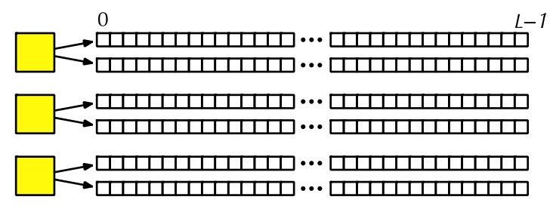
Conceptual overview
Individuals and genomes:
Individuals are diploid by default, thus each have two Genomes
Notes:
-classes indicated in blue
-haploids can be modeled by having 1 genome be NULL

Slide 12
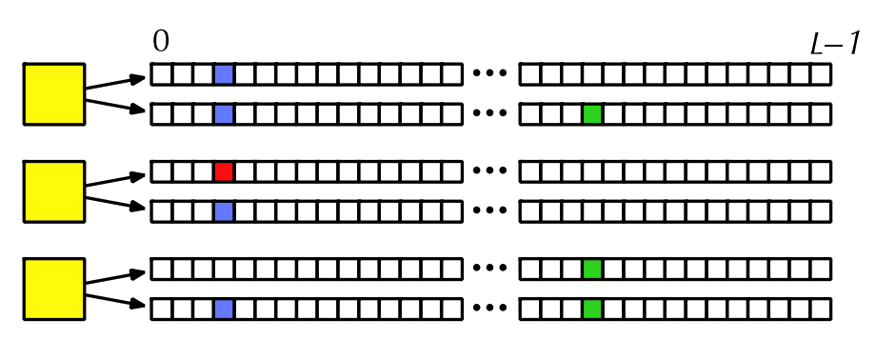
Conceptual overview
Mutations and substitutions:
Each instance of mutation (different colors) are references to the same Mutation object
Each Mutation instance stores a base position, selection coefficient s, and a dominance coefficient h

Slide 13
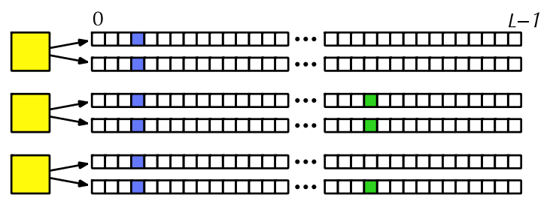
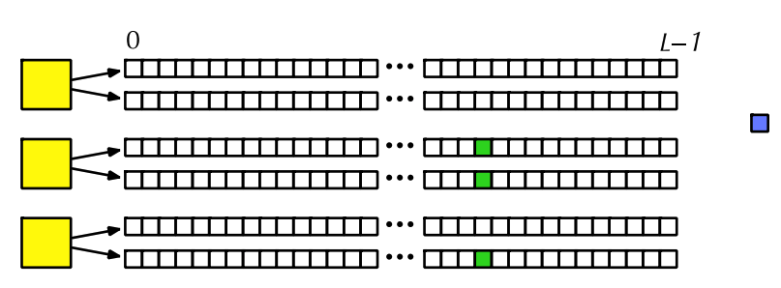
Conceptual overview
Mutations and substitutions:
When fixed in a population, a mutation is removed and stored as a substitution object (default behavior)
Notes:
-done for efficiency purposes
-fixed mutation no longer affects fitness of individuals
-turned off/on with convertToSubstitution property

Slide 14
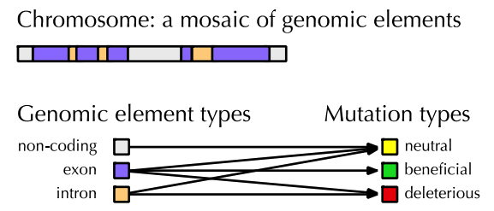
Conceptual overview
Genomic elements, genomic element types, mutation types, and the chromosome:
The Chromosome contains genomic elements (GenomicElement), which each have a genomic element type (GenomicElementType)
Notes:
-SLiM only uses this info to know where to place new mutations of a certain type

Slide 15
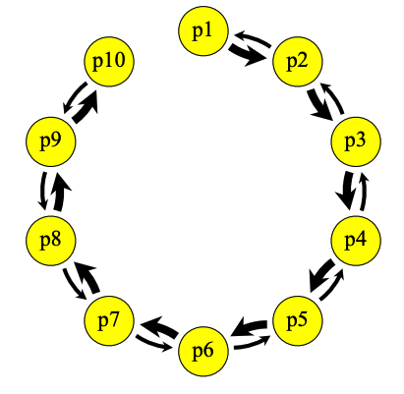
Conceptual overview
Subpopulations and migration:
Mating occurs within Subpopulations; ie. they are reproductively isolated from other subpopulations
This allows you to model gene flow, eg. the ‘stepping-stone’ river system model below

Slide 16
Conceptual overview
Subpopulations and migration:
Using spatial layers, you can also model spatial competition or spatial mate choice preference

Slide 17
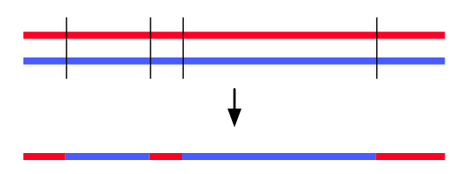
Conceptual overview
Recombination and gene conversion:
“Crossover breakpoints” model: crossover only, no gene conversion
“Double-stranded break (DSB)” model: gene conversion
Notes:
-used for most models
-selects the number of breakpoints based on recomb rate, selects locations, and flips genomes accordingly
-DSB: Gene conversion is a phenomenon in which a short stretch of DNA surrounding a DSB – a gene conversion tract – is taken from the opposite strand

Slide 18
Fitness
WF models Relative fitness- population size is set by the model fitness = probability an individual will reproduce in next generation | non-WF models Absolute fitness- fitness composition in populations actively influences their size fitness = probability that an individual will survive to reproduction (in next generation)
Both calculate fitness per individual like this: (1+s)*(1+hs)*(1+hs)*...
homozygous
heterozygous

